Slide 1
PAWZ ANIMAL SPA
Fransaita Hazelwood
ACC 202

Slide 2
ABOUT PAWZ ANIMAL SPA
Mission: PAWZ Animal Spa’s mission is to provide excellent animal care in a pet friendly environment while ensuring our customers receive excellent service in a playful atmosphere.
VISION: To be the leading animal care provider with a hands on experience providing individual attention so each animal has the best experience.

Slide 3
Services
Bathing and Drying
Ear Cleaning/ Full body cleaning
Hair Trimming
Hair Cutting and styling
Nail clipping and nail art
Tick and Flea Treatment
Deep Conditioning w/ bathing

Slide 4
Title and Content Layout with SmartArt
Step 1
Title
Step 2
Title
Step 3
Title
Step 4
Title
Step 5
Title

Slide 5
LOCATION ANALYSIS

Slide 6
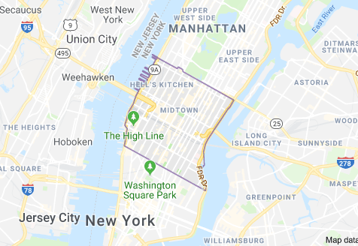
Location Analysis

Slide 7
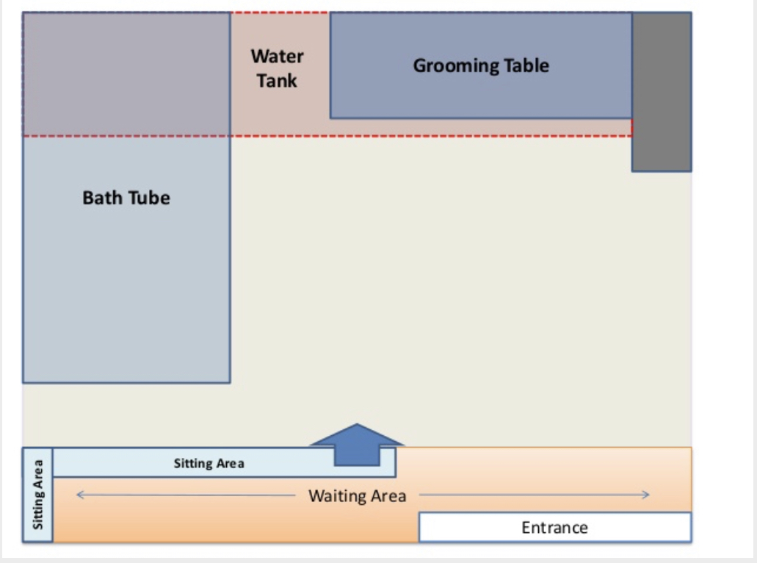
Location and Facility Analysis
PAWZ Animal Spa would be in Midtown Manhattan located in NYC. Which provides clients an easy and accessible location for convenience.
The spa would be about 200-250 square feet.
The rent for our location is estimated to be $386.90 a day based on 12 dogs per day.
The pet population in NYC is 1.1 million. The break down would be 600,000 dogs and 500,000 cats.

Slide 8
Add a Slide Title - 2
Single professionals living alone in a huge city.
Security

Slide 9
Add a Slide Title - 3

Slide 11
Add a Slide Title - 4

